Slide 1
Book Nest
Where Stories Nestle
Team Members:
1) A. Mahesh Babu - 22PA1A0502
2) B. Jaswanth – 23PA5A0504
3) D.Dinesh Eswar Reddy – 23PA5A0506
4) G. Sai Deepak Reddy - 22PA1A0550

Slide 2
Problem statement
Many readers struggle to find time to visit physical bookstores due to busy schedules. They need a convenient and engaging platform to discover books by genre or author, make purchases easily, and enjoy the browsing experience digitally — without compromising their personal reading preferences.

Slide 3
Proposed Solution
BookNest is a role-based online bookstore platform that allows users to browse and purchase books easily, sellers to manage listings and orders, and admins to control the system — all from a clean and responsive interface.

Slide 4
Technology Stack
Frontend: React.js, React Router, CSS, Bootstrap
Backend: Node.js, Express.js
Database: MongoDB Compass, Mongoose
Authentication & Security: JWT
Tools & Deployment: Git, GitHub,

Slide 5
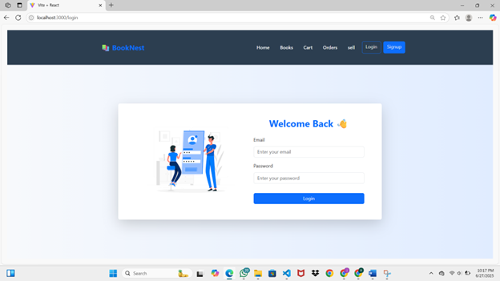
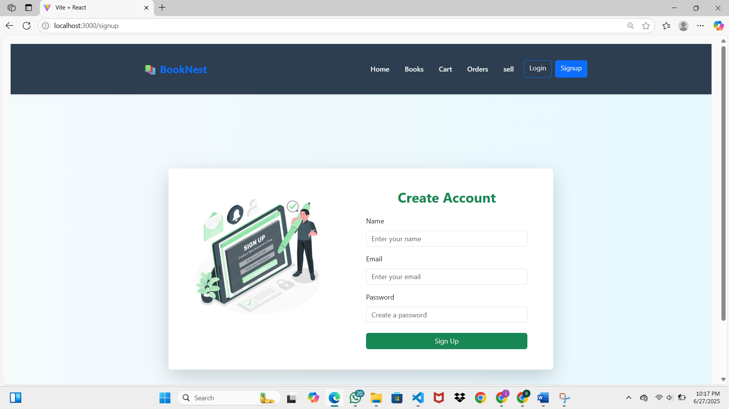
SignUp page
Login Page

Slide 6
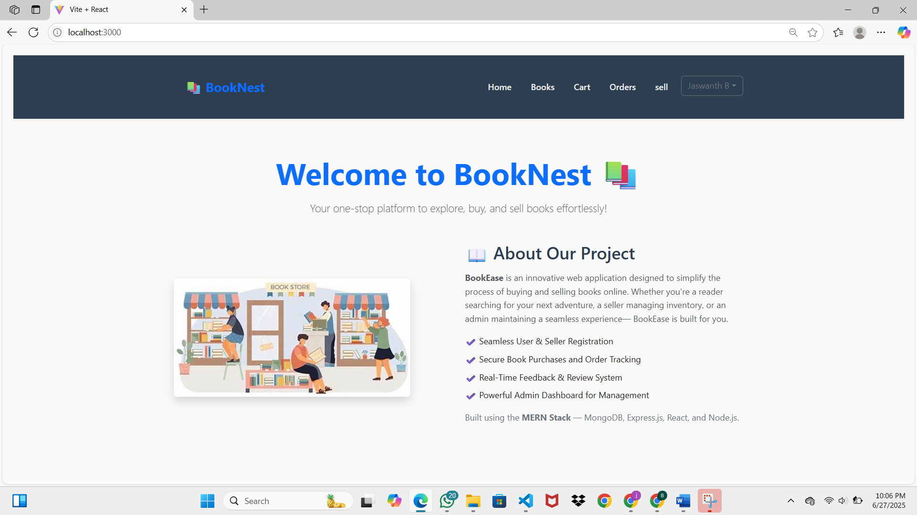
Home Page:

Slide 7
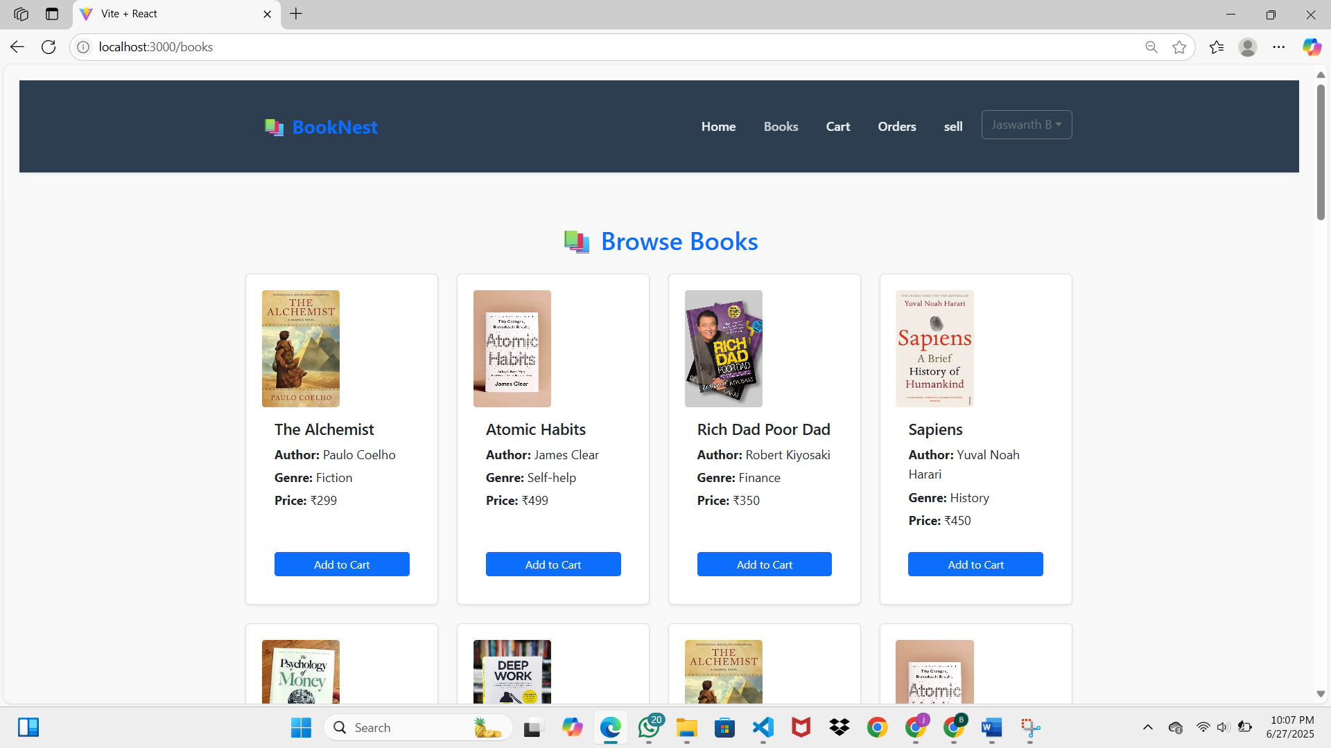
Books Page:

Slide 8
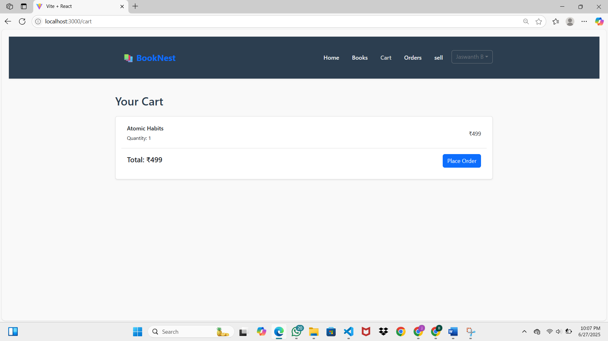
Cart Page:

Slide 9
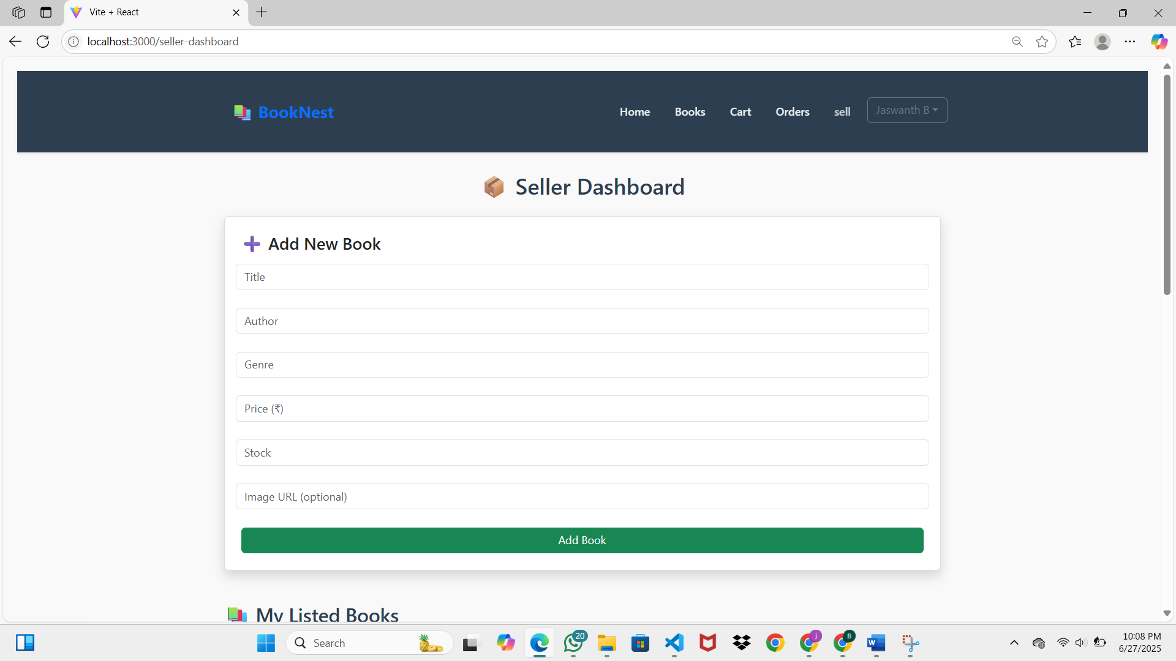
Seller Dashboard:

Slide 10
Thank You…

